Slide 1
Car Accident Prediction
In this case study we analyze the car accident data set from Seattle city and draw various important inference from it

Slide 2
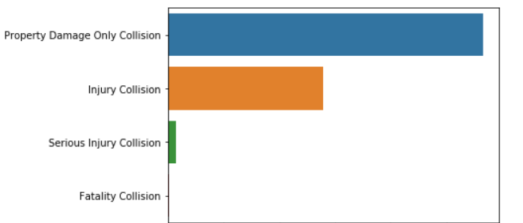
Important Inference- Severity of accidents
Most of the accident resulted in property damage

Slide 3
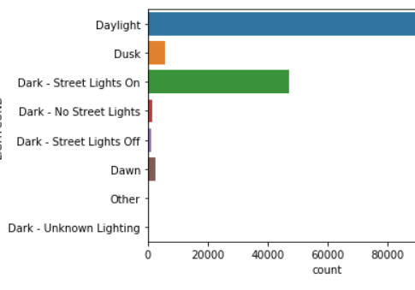
Impact of light conditions on accident
Most accident occurred under daylight

Slide 4
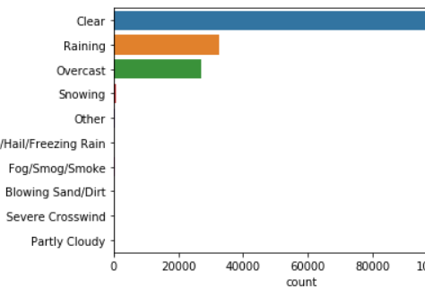
Impact of Weather on accident
Most accident occurred in Clear weather. Probable reason could be clear weather instigated drivers for rash driving

Slide 5
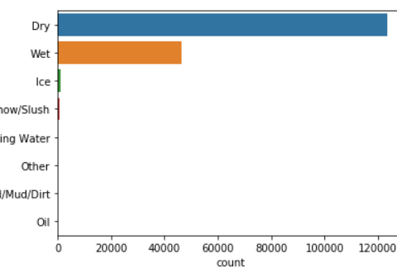
Impact of Road Conditon on accident
Most accident occurred when the road was dry

Slide 6
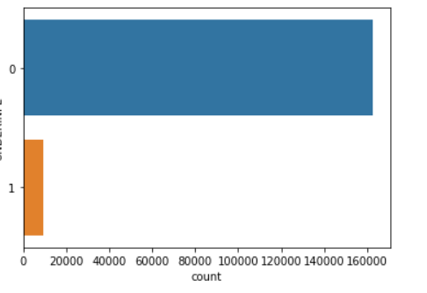
Impact of alcohol influence on accidents
Most accident occurred when driver was not under influence of alcohol.
0 means no alcohol influence and 1 means under alcohol influence
People under alcohol influence seems to drive very cautiously leading to lesser accident

Slide 7
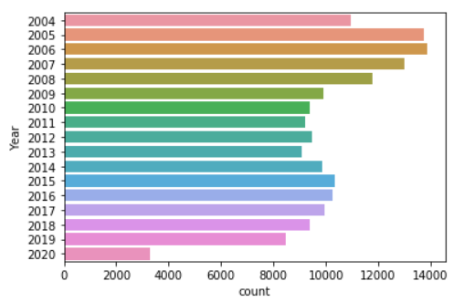
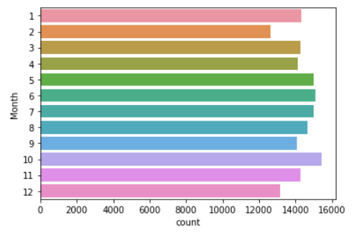
Year and Month wise accidents

Slide 8
Final Model Selection
After many testing on various models the Logistic regression model with hyperparameter C = 0.001 and solver = 'liblinear’ is selected to predict accident in Seattle city.

